Slide 1
Aged-Out Indigenous Children & Youth from the Child Welfare System
SOWK 799: MAJOR PAPER
BY Kay Swakum James

Slide 2
Introduction
This presentation is about aged-out Indigenous youth of the Child Welfare System. I will be exploring the concepts of ontology, epistemology, axiology and methodology and how it fits with First Nations perspectives and the impacts of colonialization of “Indian Problem.”

Slide 3
“Indian Problem”
Historical Context
The definition used are Indigenous, Indian and Aboriginal. I will be mainly be using Indigenous but may use other terms interchangeably. In 1490, the Europeans arrived in Canada and considered the territories of Indian people Terra Nullius which is “the land is empty and for the taking.” However, Indian people lived on these traditional lands and were considered the inferior and was the “Indian problem.”

Slide 4
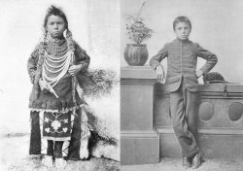
INDIAN RESDENTIAL SCHOOLS
Indigenous children were changed from their Indian culture to look like ethnocentric Western mainstream society on the outside but were Indian on the inside psychologically. That is, they thought like an Indian and most times were lost and confused of who they are once they leave the Child Welfare System and Residential School systems.
Thomas Moore: leaderpost.com

Slide 5
Historical Context & Literature Review
In 1820, the new colonial government was pressured by a flood of British homesteaders who demanded that Indians be moved off the Terra Nulluis lands to make land available for them. In the best interest of the Indians, the new Canadian colonial gov’t introduced the Indian Act in 1876. The Indian people and children were made wards of the Crown. Since then, they are the fiduciary responsibility of the colonial government according to the British North America Act. They were moved and relocated onto small inadequate unproductive lands (reserves).

Slide 6
Thematic Analysis
Indian people have been oppressed since time immemorial from ethnocentric people who consider their beliefs, values, and ways are superior (Bennett et al. 2005). Due to stringent laws made for Indigenous people through the Indian Act, Indigenous people are made poor and kept poor on the poorest inadequate strips of lands called Indian reserves (Wickwire, 2018).

Slide 7
THEMATIC ANALYSIS
Foster home shuffling
Indigenous youth are shuffled around to many different homes. They do not attain a firm foundation of a home. They do not bond with non-Indigenous foster parents. In B.C., 11% of Indigenous youth had moved two or more times. Unfortunately, data is not kept of how many moves children make.
Language
Language is eroding, especially for Indigenous youth in Child Welfare care. This is not recognised as a priority. Social Workers main interest is finding a foster home placement.
When Indigenous aged out youth exit the Child Welfare system, they are at a complete loss when they return back to the reserves where they originate from & don’t fit in because of loss of language.

Slide 8
Critical Analysis Review
Theoretical Approach
Is the theory that all human being share knowledge (epistemology), that bases itself on sharing & changing, as reality can be understood to reflect both internal and external ways of cognition. Indigenous youth should be able to ask questions about their biological parents re: experiences with the Child Welfare and Indian Residential Schools.
Indigenous children are typically placed in non-Indigenous homes.
The colonial government does not place Indigenous children in Indigenous foster homes.
Indigenous children are apprehended because of impoverished state of living such as unclean water & sanitation, inadequate housing and resources on reserves.

Slide 9
RESEARCH FINDINGS
There is a gross over-representation of Indigenous children in care which represents 48% of all children who have been apprehended and are considered wards (Indians) of the state under the MCFD (Statistics Canada, 2013).
However, research shows that Indigenous parents can look after their own children when they have access to preventative policies, services, and programs.
Indigenous youth who age out need to integrate with their bands to access education and health needs. There are education funds for “Status” Indigenous youth to continue their education and access mental health services and other.

Slide 10
WHAT SOCIAL WORKERS KNOW
Most social workers know that Indigenous parents and grandparents had attended Indian Residential Schools. After all, it was the Canadian Association of Social Workers and the Canadian Welfare Council that persuaded the colonial government that “Indian children were neglected deserved the same care as white children.”

Slide 11
Gaps about Indigenous Youth
The Child Welfare System makes structural decisions without consultation to the biological Indigenous parents or the Indian Bands. This is regarding adoption or placements of where the children are placed. Some adopted Indigenous children are sometimes never heard of again later in life.
The adopted Indigenous children’s original names are changed. Therefore, they loss their status, don’t have a clue where to start in trying to locate their families.

Slide 12
Further research needed:
Questions to ponder:
Why is Indigenous homes not considered and recruited?
Why is the age-old tradition of customary adoption not considered on Indian reserves?
Why is First Nations Delegated Organizations underfunded?
Why is history of Indian Res. Schools kept quiet from Indigenous children in care?

Slide 13
Reunification and Cultural Identity
Many aged out Indigenous youth are searching for their roots of their parents, siblings, and communities.
Youth need to be reconnected back to their communities to learn by doing activities such as fishing, hunting and gathering.
They need to hear positive stuff how Indigenous people were sustainable using botany, astronomy, and ceremonies.
Because aged out Indigenous youth did not speak their language, they felt alienated in their communities. Thus, end up moving back to urban cities where they are homeless, into substance abuse and lonely.
They have identity issues and end up in experimenting with drugs & overdose, and some commit suicide.

Slide 14
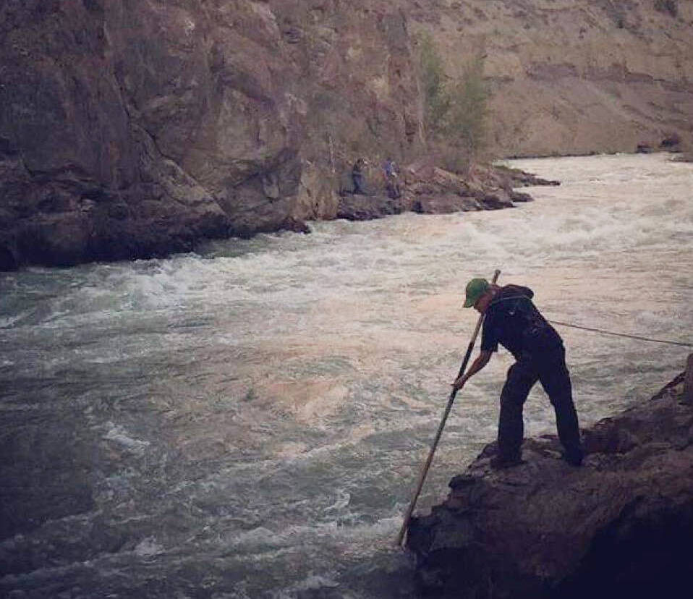
Dipnet fishing on the Fraser River
Indigenous youth miss the experience of dipnet fishing and the preparation that goes with it.
The whole community gets together prepping for the year. Fish are wind dried, canned, smoked and traded with other distant Indigenous communities.
By being on the river; there is a sense of well being psychologically of the soul; the great respect for mother earth, the water and each other. This is what Indigenous children and youth in care do not receive while in Child Welfare Care.
Fraser River sockeye fisheries…
Vicnews.com

Slide 15
RECOMMENDATIONS
1. That Delegated First Nations funding be acknowledged and distributed efficienty, effectively and equally.
2.Collaboration between Child Welfare and Delegated First Nations in the best interest of Indigenous children and youth.
3. The equity funding be dealt with Attorney General, Minister of Justice, and Solicitor General with First Nations Delegated Auth.

Slide 16
CONCLUSION
“What is reality,” ask ontology, needs to be dealt with in conjunction, epistemology is the cultural knowledge that works together with ontology. From First Nations perspective, they know how to care for their own children instead of being treated inferior. Instead of being made poor and dependent on the Government. Indigenous children need to be reunified with their culture and feel the axiology of self-identity.

Slide 17
Is there any questions?
Students will be given up to two minutes for their questions, so that all can get their questions answered.
Thank you

